Slide 1
TRAINING SYSTEM
OPERATING LEASE SUPPORT SYSTEM – PHASE 1
DSF Conference Room, 7 Aug 2015
Participant :
PT. DIPO STAR FINANCE – NBD Dept.
Trainer:
BSI Team
Supported by Mr. Abdul Somad (DSF – NBD Dept.)

Slide 2
Table of Content
Part #1 - System Design:
General Description
Process Organization
Process Flow
Part #2 - Demo Case Study
Part #3 - Practice

Slide 3
1. General Description
This system will be simple tool and is expected to manage the units (contract), and shall manage contract expiration in the near future
The main features of this application are to manage of basic information of customer, supplier, and vehicle (product) also to manage data transaction such as calculation of operating lease, calculation of refinance, maintenance service record inquiry, and billing payment status inquiry

Slide 4
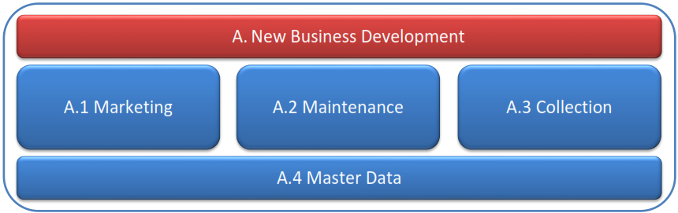
2. Process Organization
High Level Process Organization of Operating Lease Support System

Slide 5
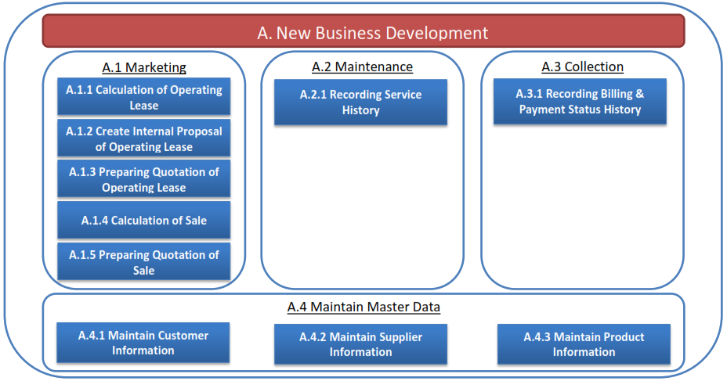
2. Process Organization
Activity Process Organization of Operating Lease Support System

Slide 6
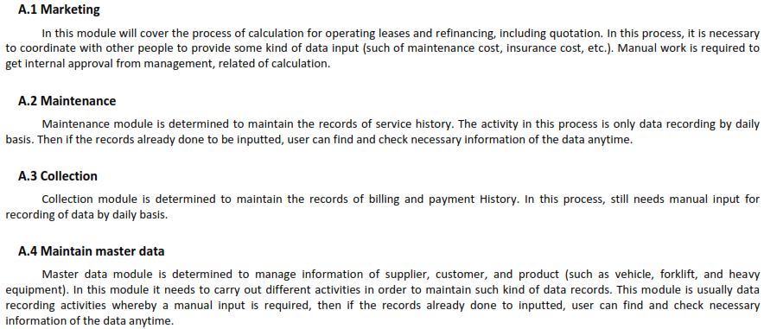
2. Process Organization
Process Description

Slide 7
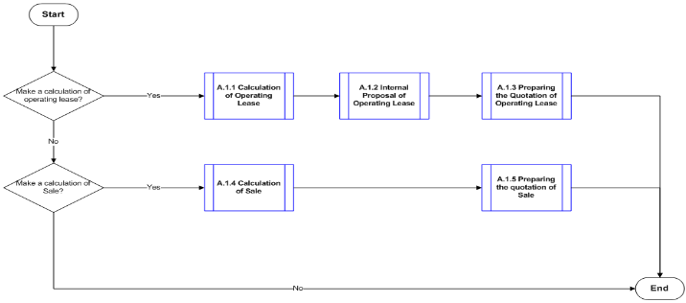
3. Process Flow
3.1 Marketing

Slide 8
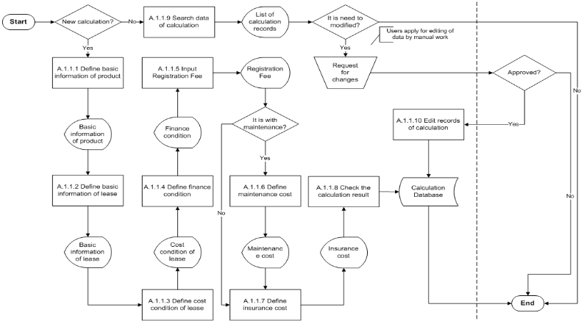
3. Process Flow
3.1.1 Calculation of Operating Lease

Slide 9
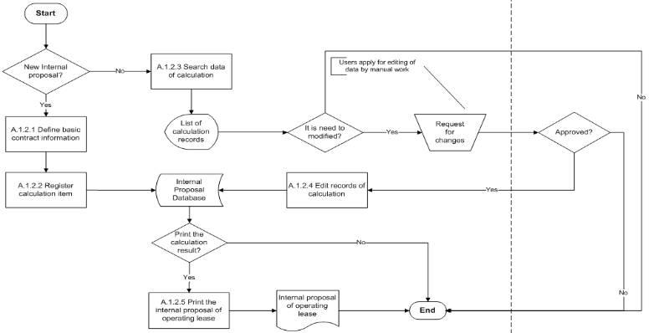
3. Process Flow
3.1.2 Create Internal Proposal of Operating Lease

Slide 10
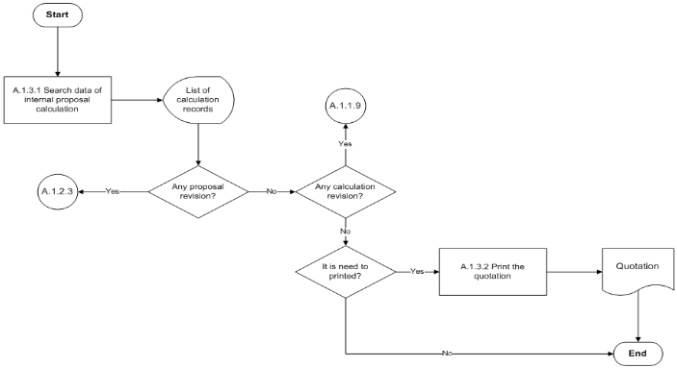
3. Process Flow
3.1.3 Preparing Quotation of Operating Lease

Slide 11
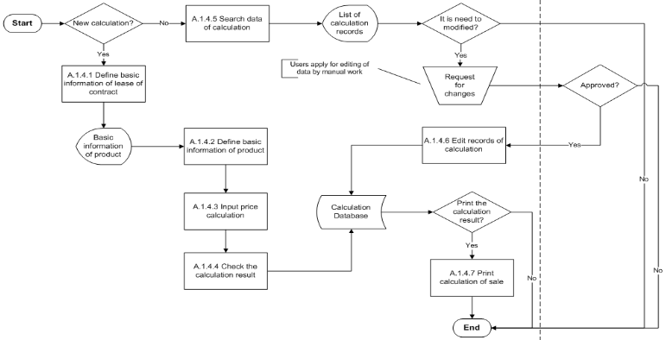
3. Process Flow
3.1.4 Calculation of Sale

Slide 12
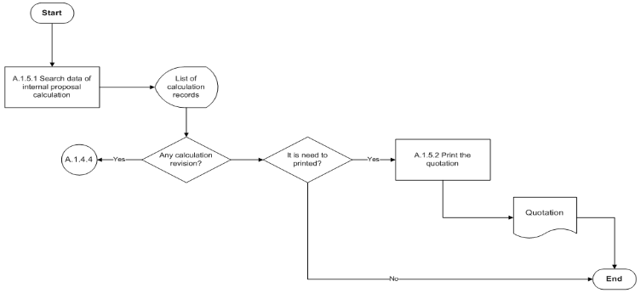
3. Process Flow
3.1.5 Preparing Quotation of Sale

Slide 13
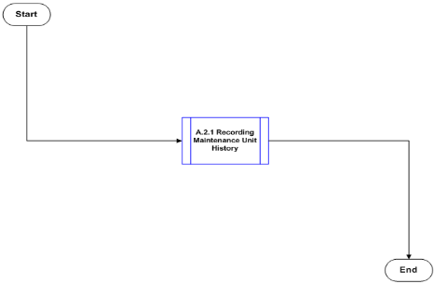
3. Process Flow
3.2 Maintenance

Slide 14
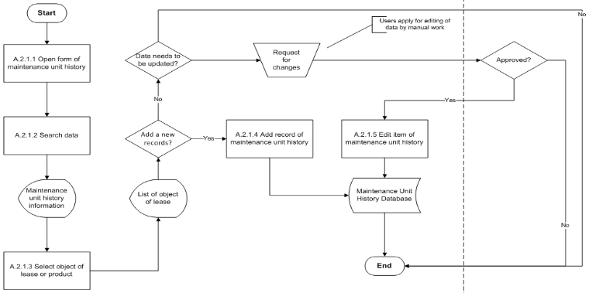
3. Process Flow
3.2.1 Recording Maintenance Unit History

Slide 15
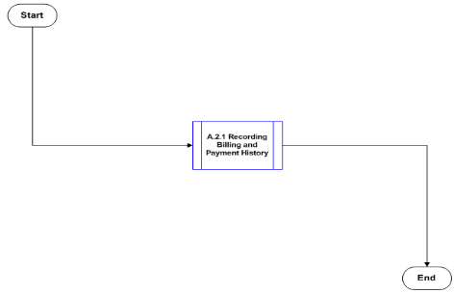
3. Process Flow
3.3 Collection

Slide 16
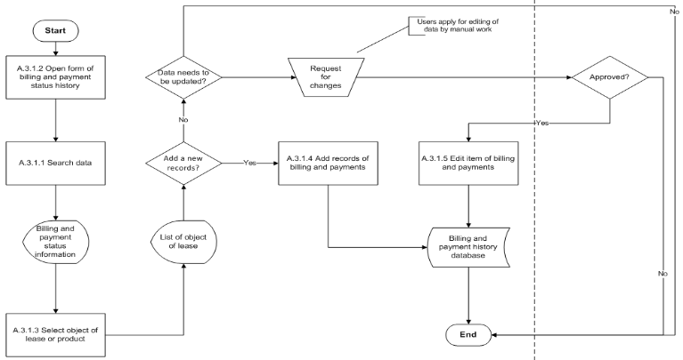
3. Process Flow
3.3.1 Recording Billing and Payment History

Slide 17
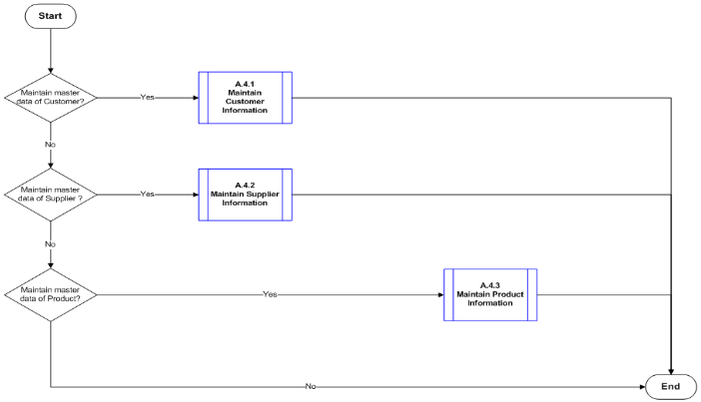
3. Process Flow
3.4 Maintenance Master Data

Slide 18
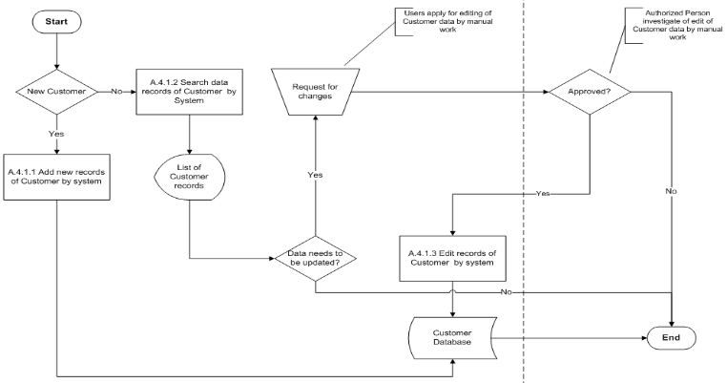
3. Process Flow
3.4.1 Maintenance Customer Information

Slide 19
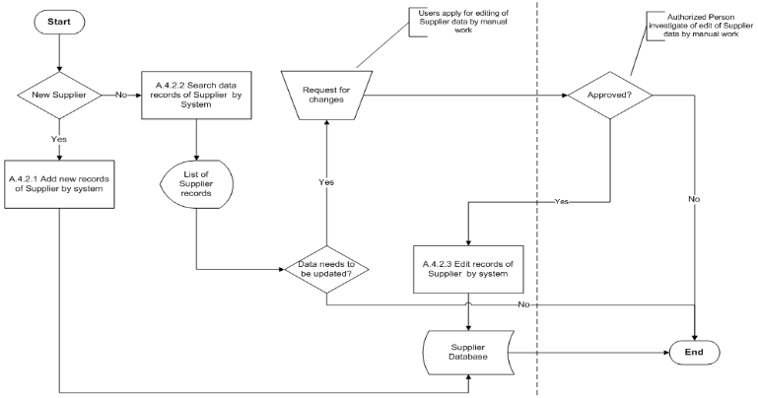
3. Process Flow
3.4.2 Maintenance Supplier Information

Slide 20
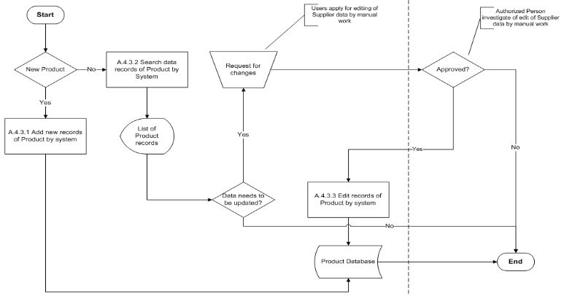
3. Process Flow
3.4.3 Maintenance Product Information

